Slide 1
Ants
Agent-Based Modeling Demonstrating
Dynamic Distribution and Neural Networking
By Andrew Erickson
December 8, 2010 / APPM 4380

Slide 2
Agent-Based Modeling
An agent-based model is the study of a system of individual entities and the complex nature that can arise.
Ants are a superorganism and are best represented with agent-based models.
Each ant is simple and acts alone.
Ant interactions in a community creates and interesting and efficient system

Slide 3
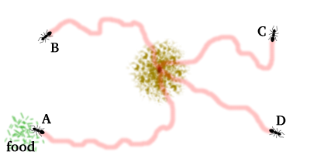
Single Ant Behavior - Wander
Wander – the default action of an ant is to wander around.
The ant walks in a fairly straight line but has a chance of taking a slight step left or right.
The “wiggle” maximizes area covered in dynamic systems.
Behavior:
Default -> Wander

Slide 4
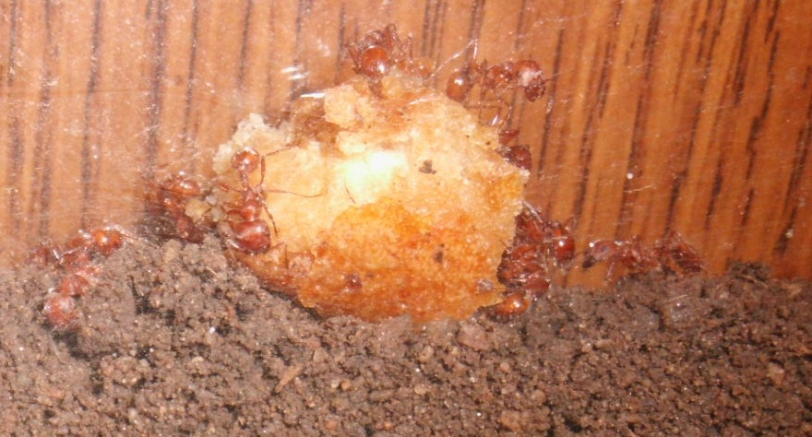
Single Ant Behavior - Food
When food is found by an ant, it gathers the food and walks towards the nest.
An ant with food leaves pheromone as it walks back to the nest. This leaves a trail that others can follow.
Behavior:
Default -> Wander
Food -> Grab, Head to Nest,
Leave Pheromone
Photo of Andrew Erickson’s Ant Farm

Slide 5
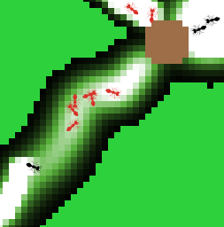
Single Ant Behavior - Pheromone
When an ant senses a pheromone trail it follows it until it finds food.
Ants Following Trail
Behavior:
Default -> Wander
Food -> Grab, Head to Nest,
Leave Pheromone
Pherm -> Follow trail
Green is area with no chemical
Black is area with very little chemical
White is area with saturated chemical
Ant Leaving Pheromone
Photo from Andrew Erickson’s Netlogo Simulation

Slide 6
Single Ant Behavior – Recruit
Ants inside the nest have a sense of how much pheromone is directly outside the nest.
When a threshold window of pheromone is satisfied a flow of ants will come out of the nest.
Behavior:
Default -> Wander
Food -> Grab, Head to Nest,
Leave Pheromone
Pherm -> Follow trail,
Recruit
No Food -> Go back into Nest
This causes the system to be able to react to a large food source by recruiting more harvesters.
This same system can be used to recruit soldier ants in the case of an attack.
If food hasn’t been found in a while, go back into the nest.
Photo from Andrew Erickson’s Netlogo Simulation

Slide 7
Single Ant Behavior
Behavior:
Default -> Wander
Found Food -> Grab food, Head to Nest,
Leave Pheromone
Pheromone -> Follow trail,
Recruit
No Food -> Go back into Nest

Slide 8
Demonstration
Things to notice
Ants with food leave pheromone.
Ants without food react to pheromone (color on screen)
Closest Food source is usually eaten first
Pheromone trails act as weighting functions. The shortest and strongest trail gets reinforced and is usually chosen. This is an example of Neural Networking.

Slide 9
Optimizing the System
The program was run about 10,000 times varying the parameters.
Most Sensitive parameters are the chemical evaporation/diffusion rate, initial population, and recruit flow rate.

Slide 10
Area Search Algorithm
Ants can give us insight into searches.
Optimal means of surveying a dynamic area.
Examples include enemy movement surveillance, measuring upper atmosphere weather, and disaster zones robots.
Ant model can tell you how much you should “wiggle” given an area to cover and the number of searchers used.

Slide 11
Area Search Algorithm - Results
After several thousand runs the following results.
Population | 1 | 2 | 3 | 5 | 10 | 20
Wiggle | 4.5 | 4 | 2 | 1 | 1 | 0
Time | 1175 | 543 | 383 | 171 | 157.1 | 67.5

